Slide 1
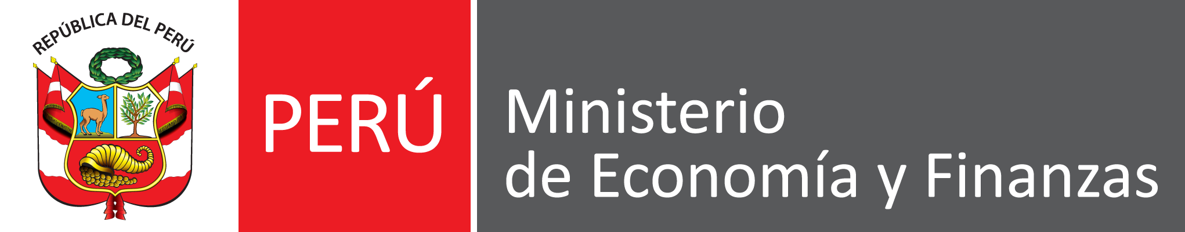

How should Peru address its natural resource curse?
To the attention of
the Ministry of Finance of Peru
November 2022
Carlos H. Víquez
MPA/ID Program

Slide 2
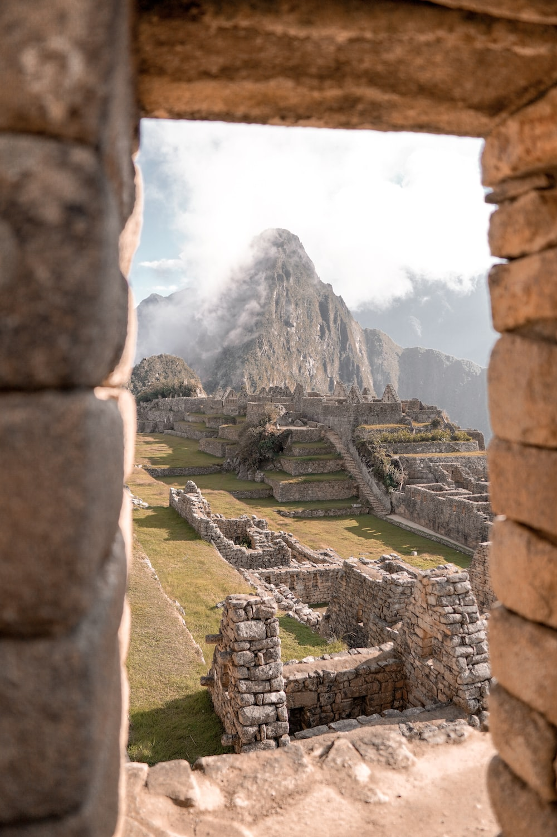
Executive Summary
Problem
Peru has a natural resource curse. The nation’s rich endowment of metals, such as copper, gold, zinc, has become a double-edge sword for its economic development. Historically, Peru’s government has adopted a procyclical fiscal policy, which means that government spending is positively correlated with commodity prices. This natural resource curse implies that in times of high commodity prices, Peru will face inflation and currency appreciation; whereas in times of low commodity prices, the nation will suffer a recession and currency depreciation.
Solution
I recommend the Ministry of Finance of Peru to adopt a countercyclical fiscal policy. In essence, if the government builds reserves when commodity prices are high, and increases government spending when commodity prices are low, then it will manage to smooth out commodity shocks in the economy. Moreover, reserves may be invested in a professionally managed and diversified portfolio. This recommendation is modeled after Chile’s fiscal rules, Norway’s Government Pension Fund and Botswana's Pula Fund.

Slide 3

Agenda
1. Motivation
2. Analysis
3. Recommendation
4. Risks & Limitations

Slide 4
Agenda
1. Motivation
2. Analysis
3. Recommendation
4. Risks & Limitations

Slide 5
Root Causes of Peru’s Natural Resource Curse
Volatility
Fluctuations in commodity prices due to inelastic supply and demand in the short run
Very costly for economic growth
Investment irreversibility
Pro-cyclicality
“Fiscal spending is more responsive to current account shocks than fiscal revenues are.”
Occurs in capital inflows, monetary policy and fiscal policy
HIGH commodity prices:
Inflation
Exp. Fiscal Policy
Currency Appreciation
Cash inflows (debt)
Crowding-out of Manufacturing
Owning natural resources decreases investment in the secondary sector
The manufacturing sector experiences learning-by-doing
Autocratic Institutions
Econometric evidence claims that having natural resources is associated with having poor institutions
For example: inequality, corruption, etc.
LOW commodity prices:
Recession
Contract. Fiscal Policy
Currency Depreciation
Cash outflows
Notes:
“Fiscal spending is more responsive to current account shocks than fiscal revenues are.”
Source: https://www.sciencedirect.com/science/article/pii/S2077188613700180
Sources:
API-119 Macro: Unit 24 Class Slides

Slide 6
Root Causes of Peru’s Natural Resource Curse
Focus: Pro-cyclicality
Volatility
Fluctuations in commodity prices due to inelastic supply and demand in the short run
Very costly for economic growth
Investment irreversibility
Pro-cyclicality
“Fiscal spending is more responsive to current account shocks than fiscal revenues are.”
Occurs in capital inflows, monetary policy and fiscal policy
HIGH commodity prices:
Inflation
Exp. Fiscal Policy
Currency Appreciation
Cash inflows (debt)
Crowding-out of Manufacturing
Owning natural resources decreases investment in the secondary sector
The manufacturing sector experiences learning-by-doing
Autocratic Institutions
Econometric evidence claims that having natural resources is associated with having poor institutions
For example: inequality, corruption, etc.
LOW commodity prices:
Recession
Contract. Fiscal Policy
Currency Depreciation
Cash outflows

Slide 7
The Correlation between Government Spending and Copper Prices in Peru is 0.83 (1980-2021)
Mining in Peru represents:
10% of GDP, while copper represents 4%
60% of exports
16% of private investments
19% of tax income
When prices of copper increase:
Terms of Trade improve substantially
Fiscal revenues increase
Peru adopts a procyclical fiscal policy
1 std. dev. shock to copper prices translates into an increase of 2% in primary expenditures
Notes:
Sources of Data:
https://www.ciat.org/metals-mining-a-bright-spot-in-peru-amid-the-governments-changing-of-the-guard/?lang=en
https://www.imf.org/en/Publications/WP/Issues/2017/09/29/The-Adjustment-to-Commodity-Price-Shocks-in-Chile-Colombia-and-Peru-45218

Slide 8
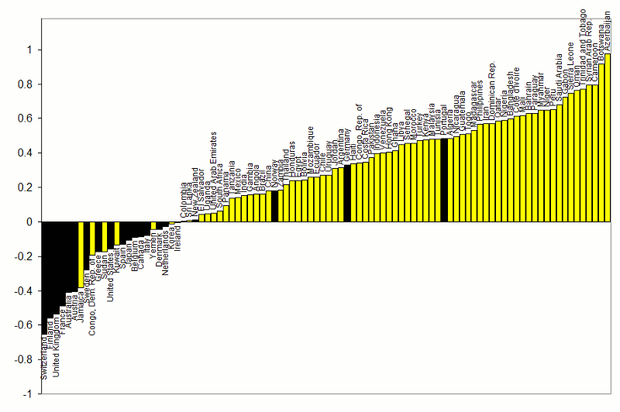
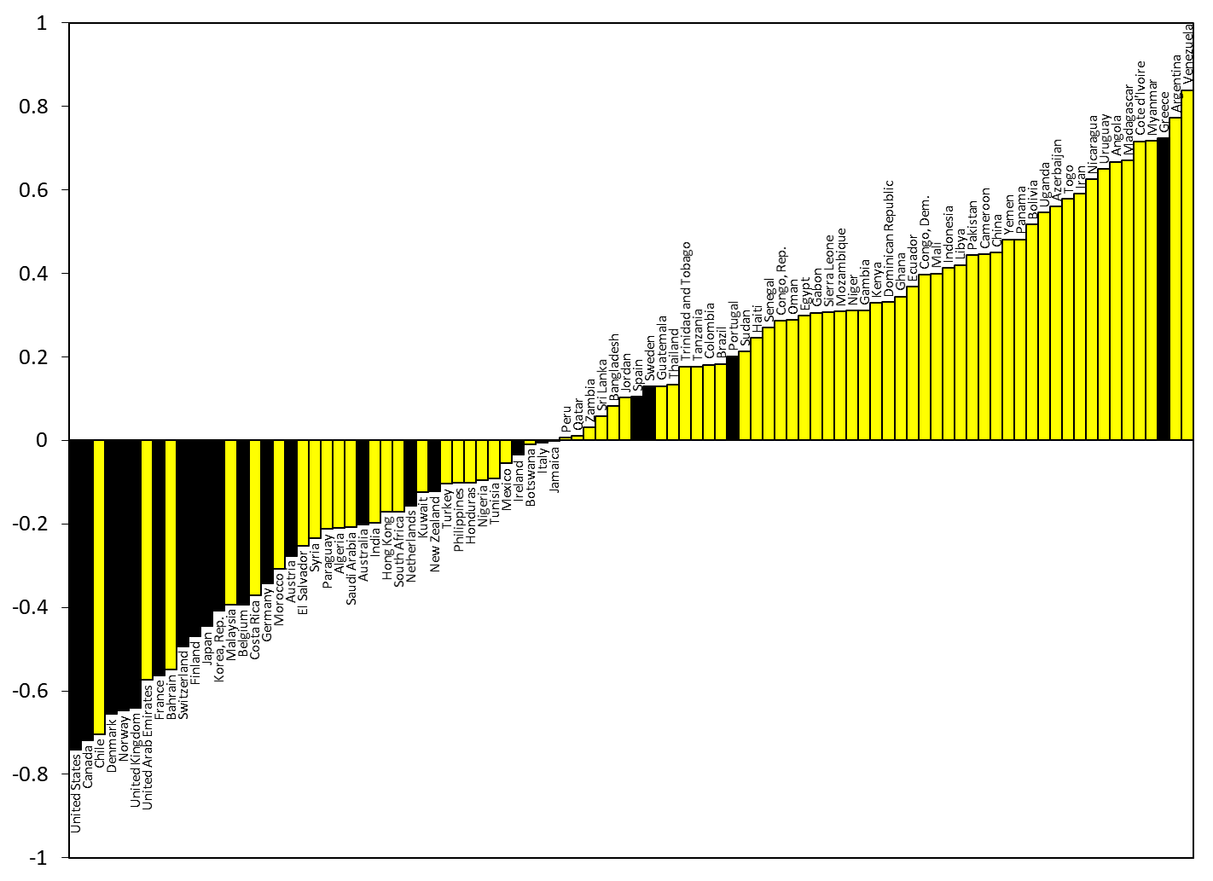

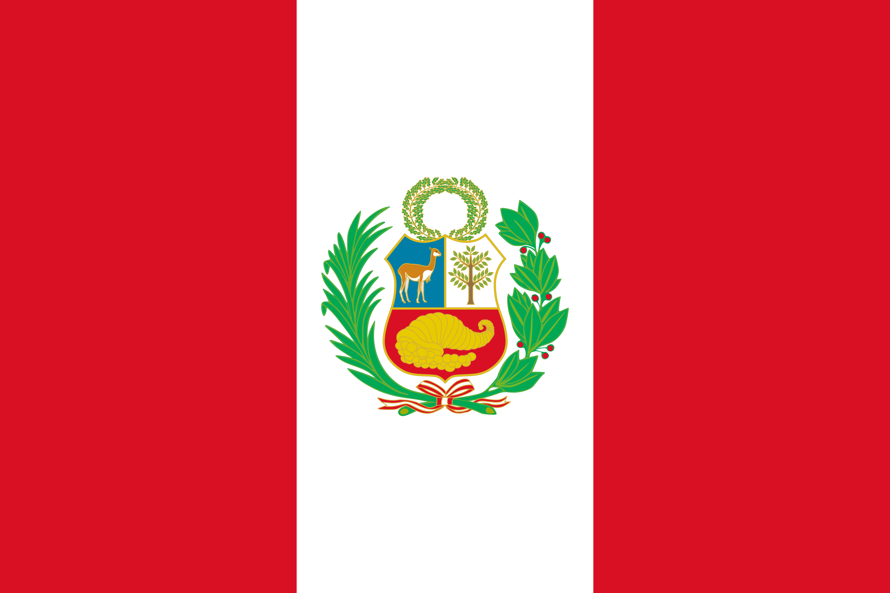
Correlation between Government Spending & GDP
Peru has had an important progress steering away from a procyclical fiscal policy, but the nation is still far from its South American neighbor, Chile, when it comes to adopting a counter-cyclical fiscal policy.
1960 - 1999
2000 - 2018
Adapted from Kaminsky, Reinhart & Végh (2004) “When it Rains, It Pours”
Updated from Frankel, Végh & Vuletin (JDE, 2013)
Source: API-119 Slides, Unit 23, Slides 19 & 21
Notes:
Source: Unit 23 Slides – API-119, Slide 19 & 21

Slide 9






Consequences of Peru’s Natural Resource Curse
1
2
3
4
5
6
Increase in commodity prices
Increase in government spending
Capital Inflows (increased debt)
Shift out of non-commodity traded goods
Currency Appreciation
Inflation

Slide 10

Agenda
1. Motivation
2. Analysis
3. Recommendation
4. Risks & Limitations

Slide 11

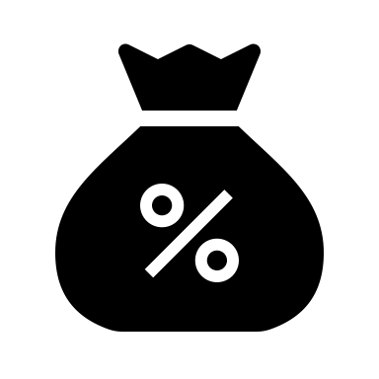

Policy Strategies to Address Peru’s Resource Curse
1
2
3
Sterilization
Tax on Capital Inflows
Fiscal Rules
Sterilize reserve inflow
Let inflow raise money supply
Appreciate currency if boom is permanent
Impose a financial transactions tax on foreign investment flows to Peru’s stock market and fixed-income securities.
When commodity revenue is high, build reserves.
Invest reserves in a professionally-managed and diversified fund

Slide 12
Policy #1
Policy Triangle:
1
Positive
Neutral
Negative
Administratively
Feasible
Technically
Correct
Politically
Supportable
Sterilization
Sterilize reserve inflow
Let inflow raise money supply
Appreciate currency if boom is permanent
Pros (+):
Postpone real appreciation
Maintain export competitiveness
Very efficient when commodity boom is transitory
If domestic currency (Sol) appreciates, exports decrease, and the economy returns to its external\internal equilibrium
Cons (-):
Sterilization only works temporarily, especially since Peru has an open capital market
This intervention does not change Peru’s procyclical fiscal policy
Politically: Exporters will be affected if domestic currency (Sol) appreciates
Notes:
Source: Unit 23 Slides – API-119, Slide 12

Slide 13
Policy #2
Policy Triangle:
2
Positive
Neutral
Negative
Administratively
Feasible
Technically
Correct
Politically
Supportable
Tax on Capital Inflows
Impose a financial transactions tax on foreign investment flows to Peru’s stock market and fixed-income securities.
Pros (+):
Higher tax revenue
Reduced pressure on the domestic currency (Sol) to appreciate
Lower international debt (that will be hard to service when commodity boom ends)
A similar tax has been implemented in Brazil
Cons (-):
Loans become more expensive
Peru becomes less attractive\competitive for international investors
When commodity prices drop, Peru will have to eliminate this tax to attract foreign direct investment
Politically: Peru has historically been an open economy for foreign investors

Slide 14
Policy #3
Policy Triangle:
3
Positive
Neutral
Negative
Administratively
Feasible
Technically
Correct
Politically
Supportable
Fiscal Rules
When commodity revenue is high, build reserves
Invest reserves in a professionally-managed fund
Adopt a counter-cyclical fiscal policy
Pros (+):
Counter-cyclical fiscal policy
Higher public savings
Internationally diversified investments
Associated with having “good institutions”
Smooth inflation across economic cycles
No political interference in investment fund
Similar fiscal rules have been invested in Chile
Botswana and Norway launched similar funds
Cons (-):
Funds will deplete in long periods of low commodity prices
Populist governments will ignore this fiscal rule if it is not declared national law
Politically: investment principles need to be approved by various stakeholders

Slide 15
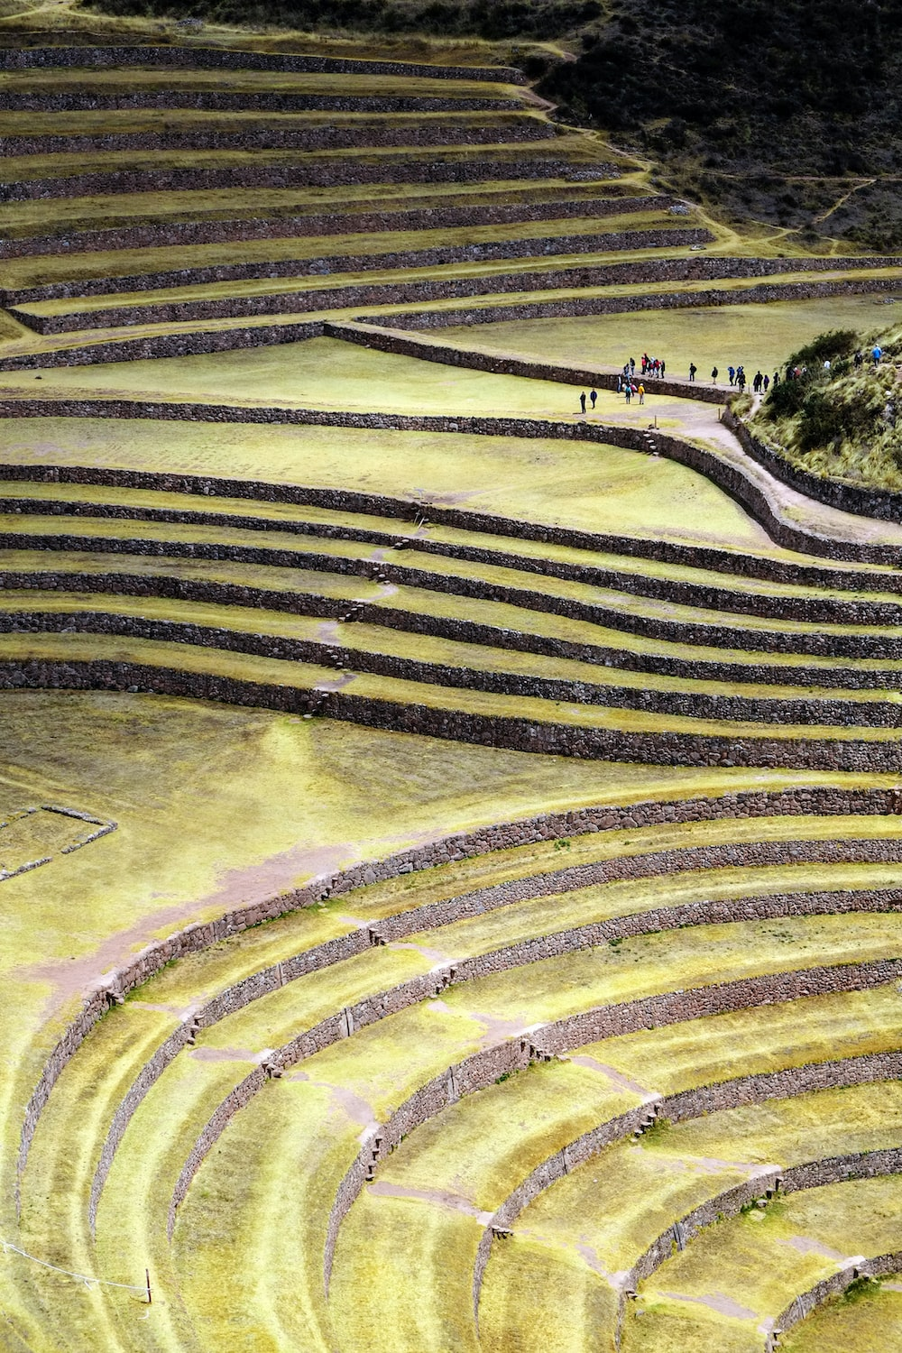
Agenda
1. Motivation
2. Analysis
3. Recommendation
4. Risks & Limitations

Slide 16
Recommendation Policy #3
Theory of Change Having copper endowments should not hinder Peru’s ability to develop. The government must put the right controls in place to avoid the pitfalls of the so-called natural resource curse.
Strategic Planning
Input
Estimate the average price of copper over a significant period.
Activity
Enact a law to build reserves when prices are above updated avg.
Average Price
Activity
Launch sovereign wealth fund with generally accepted principles.
Effects
Output
Professionally managed and internationally diversified fund.
Outcome
Peru will save resources to adopt a counter-cyclical fiscal policy.
Impact
Reduce inflation; manage appreciation; halt credit & housing boom.

Slide 17
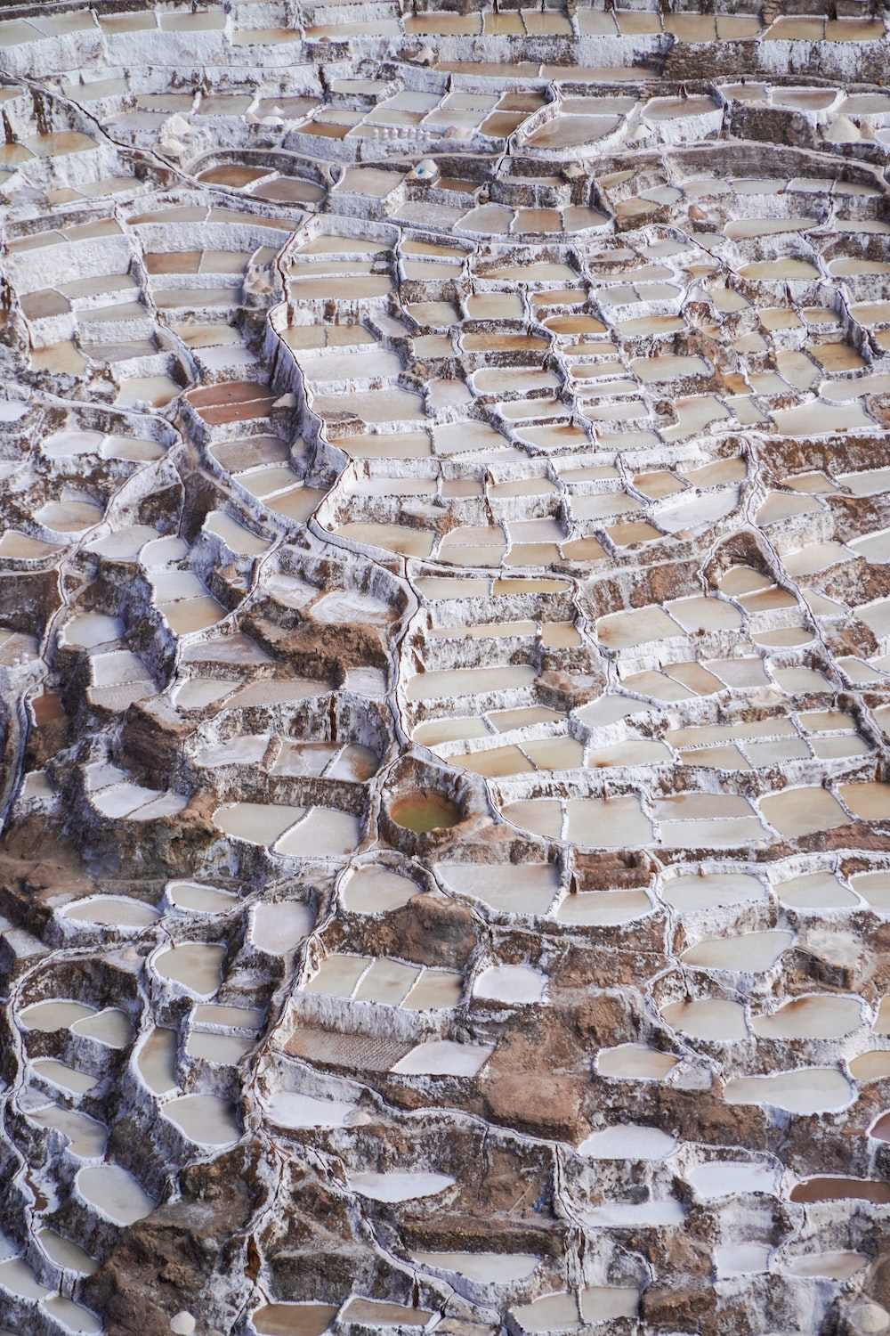
Agenda
1. Motivation
2. Analysis
3. Recommendation
4. Risks & Limitations

Slide 18
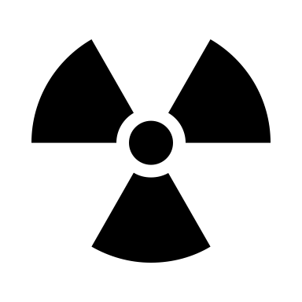


Implementation Risks & Limitations
1
2
3
Risks
Contingency Plan
Limitations
The concept of a sovereign wealth fund is hard to grasp
Communicating and explaining the policy will be challenging
The opposition will distribute fake news calling it a corruption scheme
Populist governments will try to avoid fiscal rules
Government spending may already be above the nation’s means; therefore, saving may not be feasible
Formulate clear and generally accepted investment principles so that Peruvians understand who will administer the fund and how will it be invested
Define under what conditions is the government allowed to use the resources in the fund to adopt a counter-cyclical fiscal policy
Over communicate the policy at towns and villages
Adjust government spending to its means. Forecast periods of low commodity prices.
This policy does not ensure the development of Peru’s manufacturing sector
It does not minimize the burden of volatility on irreversible private investments
It does not reduce capital inflows in the form of debt that will be hard to service when commodity prices are low
Funds are limited. They will inevitably deplete over long periods of low commodity prices.

Slide 19

Thank You

Slide 20
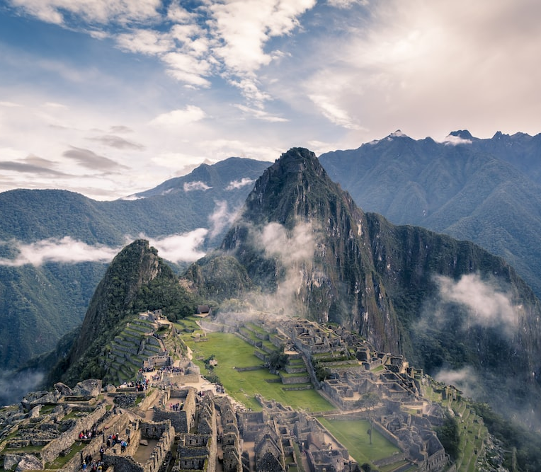
Appendix

Slide 21
Appendix I Good Institutions & Counter-cyclical Fiscal Policy
“On Graduation from Fiscal Procyclicality,” 2013, Frankel, Carlos Végh & Guillermo Vuletin; J.Dev.Ec.
Source: API-119 Slides, Unit 24, Slide 28
Notes:
Source: Unit 24 Slides – API-119, Slide 28

Slide 22
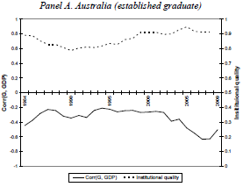
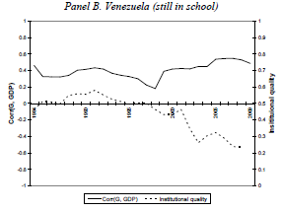
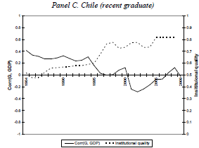

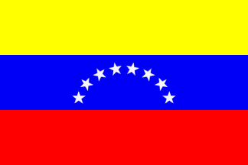

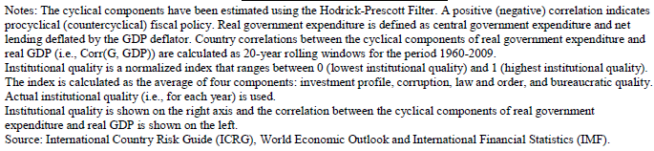
Appendix II Quality of Institutions Across Time (Australia, Venezuela & Chile)
Worsened institutions;
More-cyclical spending.
Improved institutions;
Less-cyclical spending.
Good institutions;
Countercyclical spending
Frankel, Végh & Vuletin, 2013.
Source: API-119 Slides, Unit 24, Slide 29
Notes:
Source: Unit 24 Slides – API-119, Slide 29

Slide 23

Twitter Feed

Slide 24
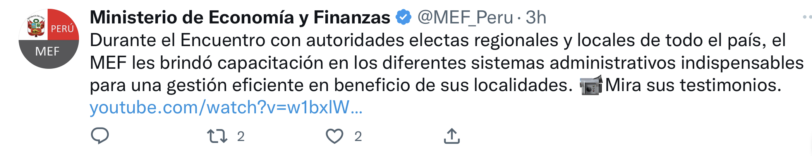
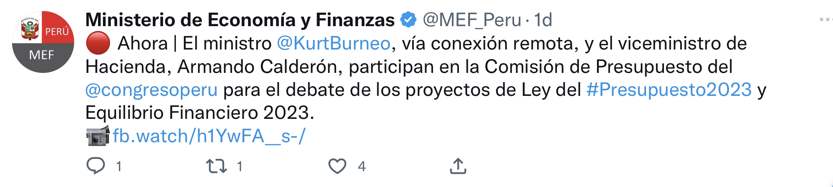
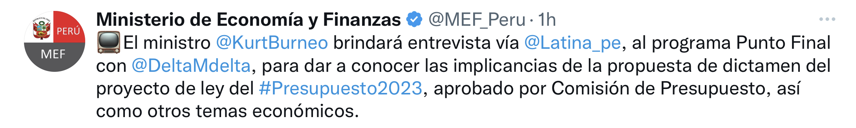
Twitter Feed
Thanks to our new fiscal rule, the government will start saving in times of abundance. Building reserves is necessary to increase government spending when commodity prices are low. Our new fund, called “Peru Prospera,” will serve as our insurance policy! #PeruProspera #Save #InsurancePolicy
Peru Prospera, our new sovereign wealth fund, will be invested in an internationally diversified portfolio. Additionally, Peru Prospera will be professionally managed, which means that it will have no political interference. #InternationallyDiversified #ProfessionallyManaged #PeruProspera
Let’s avoid inflation. Let’s maintain our competitiveness as exporters. Let’s save when commodity prices are high to overcome the next economic recession. Our new fund, Peru Prospera, will help us achieve that and more. Please find a detailed explanation in the link in bio. #GoodInstitutions #BestPractices #PeruProspera

Slide 25
Twitter Feed (continued)
In 2013, we suffered a credit and hosing boom in Peru. Bank credit grew at an annual rate of 20% for more than 4 years. This happens when commodity prices are high and government spending goes through the roof. We can avoid this simply by saving our excess in tax revenues. #PeruProspera #Save #Future #Austerity
Peru Prospera ensures that our children will have a bright future in the event of a fall in commodity prices. Invest in future generations by supporting the creation of our innovative sovereign wealth fund. #FutureGenerations #ProfessionallyManaged #PeruProspera
The Ministry of Finance has put together a list of generally accepted principles that will dictate how our sovereign wealth fund will be invested. Please find the complete guidelines in our link in bio. On top of that, we will host Q&A sessions in major towns across the country. #GoodInstitutions #Transparency #PeruProspera

Slide 26

Main References

Slide 27
Main References
Cesar R. Sobrino, Science Direct, “The Twin Deficits Hypoothesis and Reverse Causality: A short-run analysis of Peru, https://www.sciencedirect.com/science/article/pii/S2077188613700180, Accessed November 2022
Francisco Roch, International Monetary Fund, https://www.imf.org/en/Publications/WP/Issues/2017/09/29/The-Adjustment-to-Commodity-Price-Shocks-in-Chile-Colombia-and-Peru-45218, Accessed November 2022
Gerelyn Terzo, Inter-American Center of Tax Administration, “Metals Mining a Bright Spot in Peru amid Government’s Changing of the Guard,” https://www.ciat.org/metals-mining-a-bright-spot-in-peru-amid-the-governments-changing-of-the-guard/?lang=en, Accessed November 2022
Jeffrey Frankel, Harvard Kennedy School, API-119: Advanced Macroeconomics for the Open Economy, Lecture Slides Units 23 & 24
The Global Economy, “Peru’s Economic Data,” https://www.theglobaleconomy.com/download-data.php?strsixmnt, Accessed November 2022
Macro Trends, “Copper Prices – 45 Year Historical Chart,” https://www.macrotrends.net/1476/copper-prices-historical-chart-data, Accessed November 2022
Unsplash, “Photos Peru,” https://unsplash.com/s/photos/peru, Accessed November 2022

